Slide 1
OVERVIEW PL & RPL REKAYASA PERANGKAT LUNAK CSG2J3
by : Tim Pengajar RPL
Teknik Informatika – Telkom University

Slide 2
Agendas
Academic Integrity & Professional Practice
Cara Belajar Kita
Definisi PL
Peran PL
Definisi RPL
Mitos dalam RPL
What is Good Software

Slide 3
Tujuan mempelajari RPL
Memahami konsep rekayasa perangkat lunak.
Mampu melaksanakan analisis kebutuhan, perancangan, implementasi dan pengujian perangkat lunak dengan pendekatan terstruktur.
Mampu menyusun dokumentasi pengembangan perangkat lunak.

Slide 4
Academic Integrity & Professional Practice
Software Engineering is a collaborative activity. You are encouraged to work together, but ...
Some tasks may require individual work.
Always give credit to your sources and collaborators.
Good professional practice: To make use of the expertise of others and to build on previous work, with proper attribution.
Unethical and academic plagiarism: To use the efforts of others without attribution.

Slide 5
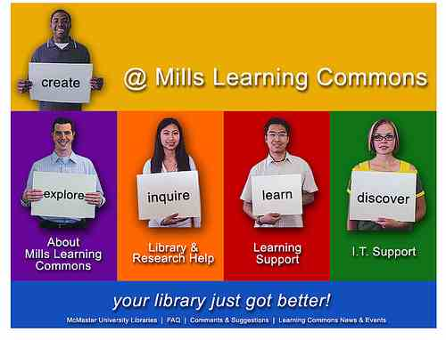
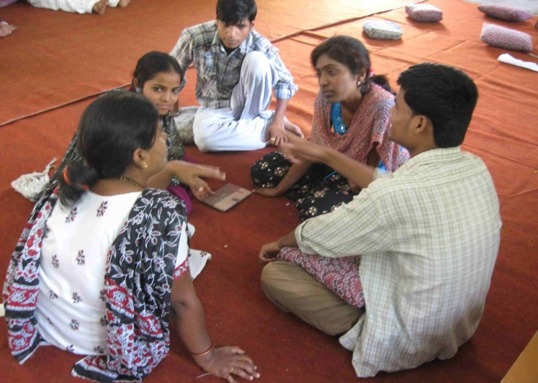

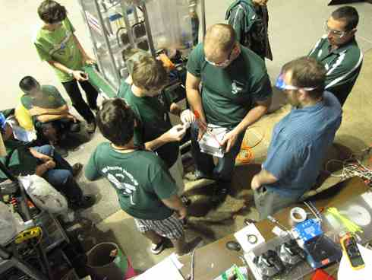
Sistem belajar kita: Student Centered Learning

Slide 6
Aturan
Toleransi keterlambatan?
Mengikuti aturan institusi :
Kehadiran & Plagiarisme
Tidak ada quiz susulan
Tidak ada perbaikan nilai di akhir perkuliahan
Kerjakan sebaik mungkin

Slide 7
Definisi dan peran perangkat lunak
Bagaimana menurut anda ... ???
What is software...

Slide 8
Definisi Rekayasa
Rekayasa adalah penerapan kaidah-kaidah ilmu dalam pelaksanaan suatu projek
Dalam membuat perangkat lunak, bisakah rekayasa kita lakukan sendiri atau harus berkelompok ?

Slide 9
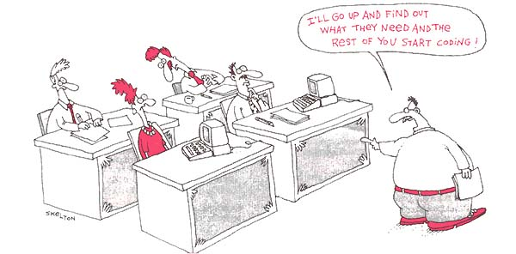

Slide 10
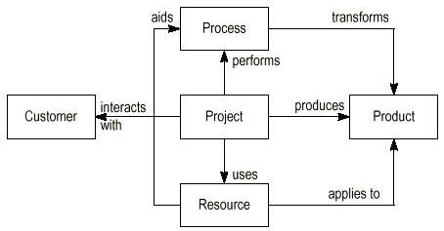
Software Engineering ...

Slide 11
Software Engineering Standards versi IEEE
Fokus Pembahasan Kuliah
5 PRIMARY
LIFE CYCLE PROCESSES
8 SUPPORTING
LIFE CYCLE PROCESSES
6.1 Documentation
5.1 Acquisition
6.2 Configuration Management
5.2 Supply
6.3 Quality Assurance
5.3 Development
5.4 Operation
6.4 Verification
6.5 Validation
6.6 Joint Review
5.5 Maint.
6.7 Audit
6.8 Problem Resolution
4 ORGANIZATIONAL LIFE CYCLE PROCESSES
7.1 Management
7.2. Infrastructure
7.3 Improvement
7.4. Training

Slide 12
Definisi RPL
Software engineering: an engineering discipline which is concerned with all aspect of software production from the early stages of system specification through to maintaining the system after it has gone into use.

Slide 13






Large Scale App
Revenue:
$239,9 juta/tahun
Revenue:
$ 1,2 Milyar (2007)
Revenue by Ads:
$ 11,7 juta/tahun
Revenue:
$8,73 Milyar (2009)
Revenue by Ads:
$ 17,186/tahun
Revenue:
$74 juta (2008)

Slide 14
Mitos dalam RPL
The myths affect :
managers,
customers (and other non-technical stakeholders)
and practitioners

Slide 15
Customer Myths
A general statement of objective is sufficient to begin writing programs – we can fill in the details later.
An ambiguous statement of objectives is a recipe for disaster!
Change can be easily accommodated because software is flexible
Yes! But it will impact the cost, time, resource, and etc..

Slide 16
Practitioner’s Myths
Once we write the program and get it to work, our job is done
Between 60-80% of all effort expended on software will be expended after it is delivered
Until I get the program running, I have no way of assessing its quality
Software quality assurance mechanisms are important!
The only deliverable work product for a successful project is the working program
Documentation is need as guidance for software support
Software engineering will make us create voluminous and unnecessary documentation and will invariably slow us down
Software engineering is not about creating document!

Slide 17
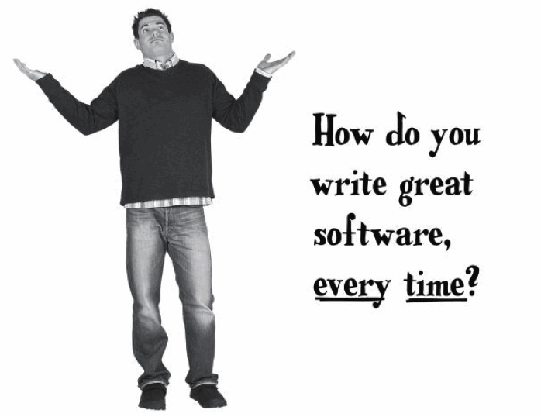

Slide 18
Management Myths
The book of standards can answer all the questions
No! unless it is used, reflect modern SW engineering practice, complete, and adaptable
If we get behind schedule, we can add more programmers and catch up
Adding people to a late SW project makes it later!
Outsourcing the project, so I can relax
Of course not!

Slide 19
Great Software !!!
SW must do what customer wants to do...
Great sw is well-designed, well-coded and easy to maintain, reuse and extent.

Slide 20
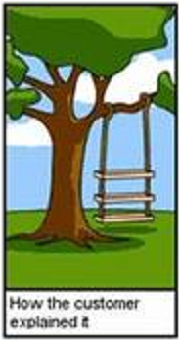
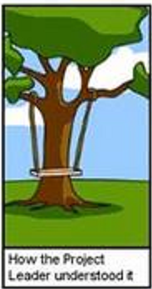
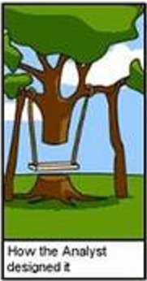
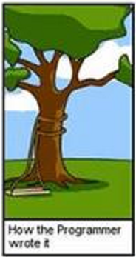
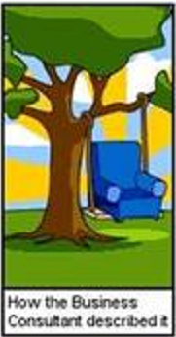

Slide 21
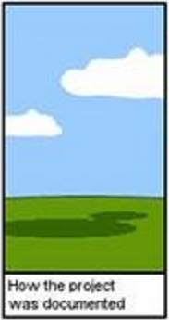
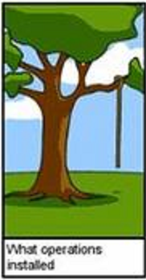
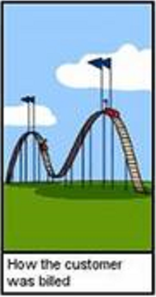
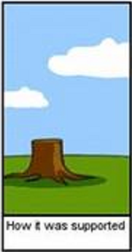
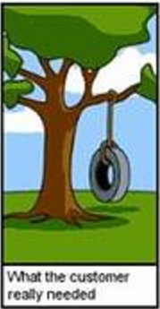

Slide 22
Terima Kasih ....

